Slide 1
ENPM695 Secure Operating Systems
Jonas Amoonarquah

Slide 2

Parts of an operating system
February 12, 2019

Slide 3
What is a secure operating system?
Work with two possible definitions
“A secure operating system provides security mechanisms that ensure that the system’s security goals are enforced despite the threats faced by the system.”*
What is a security goal?
A security goal defines the operations that can be executed by a system while still preventing unauthorized access*
Security goals fall into three broad categories:
Confidentiality
Integrity
Availability
*Jaeger, Trent, “Operating System Security”, Morgan & Claypool, 2008

Slide 4
Alternate Definition
“A secure operating system is an operating where its access enforcement satisfies the reference monitor concept”*
Reference monitor
Considered a foundation of secure computer design

Slide 5
Four design requirements
Complete Mediation
Tamperproof
Evaluation
Verifiable

Slide 6
Security Kernels
Multics was winding down
Secure Communications Processor (Scomp) (Honeywell)
Gemini Secure Operating System (GEMSOS) (Gemini),
Secure Ada Target (SAT) (Honeywell) and LOCK (Secure Computing)
Both based on the Provably Secure Operating System (PSOS) design
Kernelized Secure Operating System (KSOS) (Ford Aerospace and Communications)
Boeing Secure LAN (Boeing)

Slide 7
Security Kernel Principles
Must implement a specific security policy
The design of the security kernel must define a verifiable protection behavior of the system as a whole
Kernel implementation must be shown to be faithful to the security model’s design

Slide 8
Security kernels: SCOMP
Applications
Scomp Kernel Interface Package
(Libraries)
Ring 3 (untrusted)
Scomp Kernel Interface Package
(Trusted Functions)
Ring 2 (trusted)
Scomp Trusted
Computing Base
Scomp Kernel Interface Package
(Scomp Trusted Software)
Ring 1 (trusted)
Scomp Kernel Interface Package
(Security Kernel)
Ring 0 (trusted)
Scomp Hardware
Jaeger, Trent, “Operating System Security, Chapter 6, Morgan & Claypool, 2008

Slide 9
Scomp: Security protection module
Security
Protection
Module
I/O
Controller
Memory
CPU
Virtual
Memory
Unit
CPU
Bus Logic
I/O Bus
Jaeger, Trent, “Operating System Security, Chapter 6, Morgan & Claypool, 2008

Slide 10
Operating system – a general view

Slide 11
Boot process (x86)

Slide 12
Bootloaders (General)
First sector of a hard disk is called the Master Boot Record
512 bytes long
Contains the primary book loader
446 bytes long
Partition table
64 bytes long
Describes primary and extended partitions
MBR code looks for the active partition loads the boot sector into memory and passes control to it

Slide 13
Hardware attacks
Backdoors
Interruption of normal behavior
Glitching attcks
Counterfeit components
Backdoors
Rakshasha
Gate Level

Slide 14


Slide 15
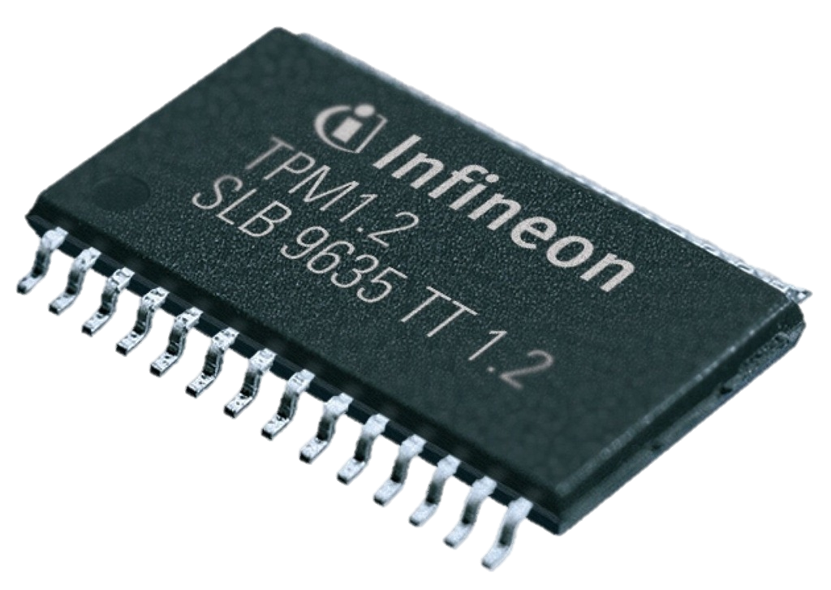
Trusted Platform Module
Implements cryptographic protection
A separate processor (smartcard chip) mounted on the motherboard
Used to protect cryptographic keys
Works with memory features to
create isolated memory spaces
Notes:
D. Understand security capabilities of information systems (e.g., memory protection, virtualization, trusted platform module, interfaces, fault tolerance)
DEFINITIONS:
Trusted Platform Module (TPM). A TPM chip is a tamper-resistant integrated circuit built into some motherboards that can perform cryptographic operations (including key generation) and protect small amounts of sensitive information, such as passwords and cryptographic keys. [101]

Slide 16
Trusted platform module internals

Slide 17
Parts of an operating system
Hardware
BIOS
Software
Kernel
Kernel Modules/Device Drivers
User environment
System programs
Utilities (mv, cp, rm – UNIX; move, copy, del – Windows)
Applications
OpenOffice, Emacs, Matlab, Office 2016, Photoshop

Slide 18
Kernel Functionality
Loads applications into memory
Handles process scheduling
Ensures processes do not interfere with each other
Provides for memory management
Data security
File management
Device Drivers/Kernel Modules
Provide functionality of specific hardware components
SCSI devices
Network
Printers

Slide 19
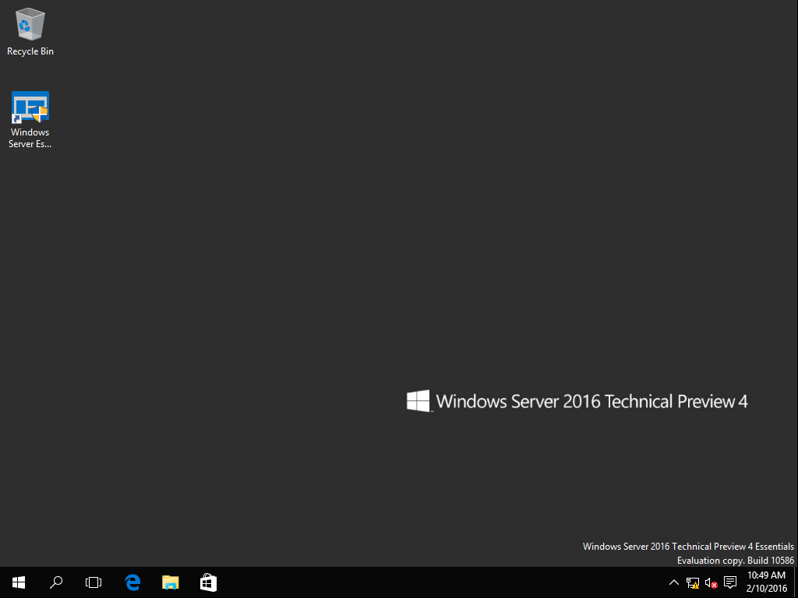
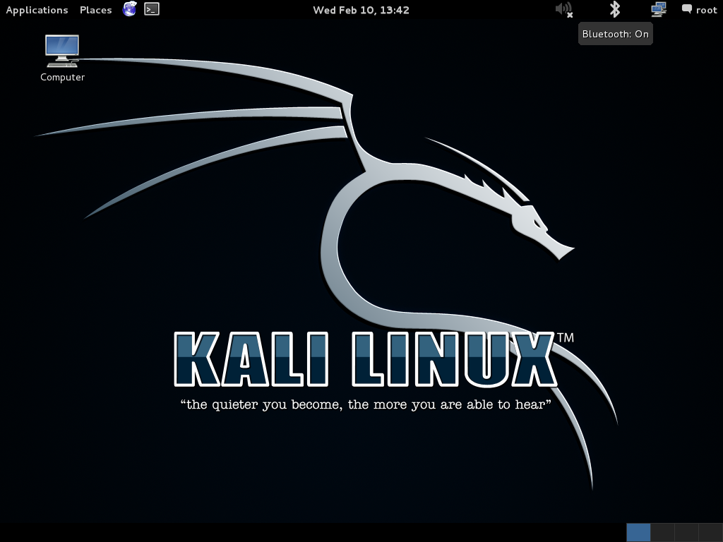

User environment
GNOME/X Windows (UNIX)
Windows
MacOS

Slide 20
Operating system tasks
Process Management
Memory Management
File System Management
Device Management
Error Management
Auditing
Security

Slide 21
Some protections in modern Operating Systems

Slide 22
Classic buffer overflows
char buf[4];
strcpy(buf, “AAAABBBB”);

Slide 23
Classic buffer overflows
char buf[4];
strcpy(buf, “AAAABBBB”);
Overwrites other memory
Here: the allow_root_access flag

Slide 24
stack buffer overflow ATTACK
Low address
string grows
Local variable (buffer)‏
Stack grows
Inject malicious code into the virtual space of a process;
Modify the content of RET to redirect the execution flow to the malicious code.
RET
Attack Code
High address
Top of Stack

Slide 25
Buffer overflow prevention
Why do buffer overflows happen?
Human error
Unsafe languages
How do we fix that?
Make people aware
Mixed results
Make the language safe
Verify software

Slide 26
Buffer overflow prevention
Bare pointers are very, very bad!
Solution – type safe languages
Python, Ruby, Java
Dynamic approaches
Bounds checking gcc
Slight problem: overhead
Same goes for valgrind
Static verification
Combine the approaches
Better – but requires a broader approach

Slide 27
NX/DEP/ESP – Preventing exploitation
Simple concept: make the stack, heap, etc. non-executable
Code pages: r-x
Data pages: (like stack, heap): rw-
The combination of the two must NEVER exist
Used correctly it effectively prevents foreign code execution
Additional security comes at some cost
Current state: hardware support – works very well

Slide 28
Executable stack protection
The problem:
Buffer overflow attacks usually inject code into a program’s data area or stack
System call used to jump to this code
This is not how it’s “supposed to be”
Executable stack protection is supposed to prevent this
Marks the stack as non-executable
Examples
NX (No eXecute) bit (hardware)
W^X (OpenBSD)

Slide 29
Not a panacea though
Circumventing NX: return into libc
Exploits also can circumvent NX using return-oriented programming (ROP) techniques
Also, Just-in-Time spraying (JIT)

Slide 30
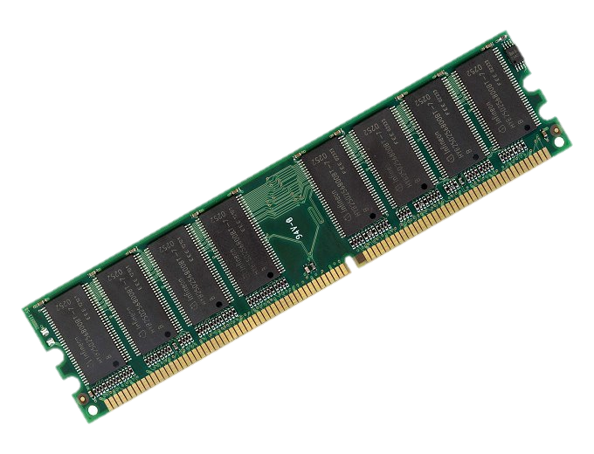
Memory Protection – Without ESP
Executable
Stack
Protection
Any data here could be executed
Malicious code disguised as data could be executed
Notes:
D. Understand security capabilities of information systems (e.g., memory protection, virtualization, trusted platform module, interfaces, fault tolerance)
DEFINITIONS:
Memory Protection. A technique that prohibits one program in memory from accidentally clobbering another active program in memory. Using various methods, a protective boundary is created around the program, and instructions within the program are prohibited from referencing data outside of that boundary. [102]
Processor State. (Need to find a good definition)
Layering. The organization of programing into separate functional components that interact in some sequential and hierarchical way with each layer usually having an interface only to the layer above it and the layer below it. [104]
Process Isolation. Protection mechanism provided by the operating systems that can be implemented as encapsulation, time multiplexing of shared resources, naming distinctions, and virtual memory swapping. [500]
Data Hiding. Use of segregation in design decisions to protect software components from negatively interacting with each other. Commonly enforced through strict interfaces. [500]

Slide 31
Memory Protection – ESP
Executable
Stack
Protection
Executable
memory
Non-executable
memory
Data is put into safe memory and not executed
Notes:
D. Understand security capabilities of information systems (e.g., memory protection, virtualization, trusted platform module, interfaces, fault tolerance)
DEFINITIONS:
Memory Protection. A technique that prohibits one program in memory from accidentally clobbering another active program in memory. Using various methods, a protective boundary is created around the program, and instructions within the program are prohibited from referencing data outside of that boundary. [102]
Processor State. (Need to find a good definition)
Layering. The organization of programing into separate functional components that interact in some sequential and hierarchical way with each layer usually having an interface only to the layer above it and the layer below it. [104]
Process Isolation. Protection mechanism provided by the operating systems that can be implemented as encapsulation, time multiplexing of shared resources, naming distinctions, and virtual memory swapping. [500]
Data Hiding. Use of segregation in design decisions to protect software components from negatively interacting with each other. Commonly enforced through strict interfaces. [500]

Slide 32
Address space layout randomization
Pre-ASLR operating systems loaded code into predictable, repeatable areas in memory
Even rebooting did not always help
System libraries would also be loaded repeatedly in the same space
Makes it more difficult for an attacker to predict target addresses
Requires the attacker to locate the code being exploited

Slide 33
ASLR Information
Introduced into Linux in 2005 with kernel 2.6.12
Forced on every executable
Microsoft requires the executable to be linked with ASLR support
Affects shared libraries and executables
Caveats
Any area of memory not randomized defeats the purpose of ASLR
Affects Windows and Linux < kernel 2.6.22
Linux – text segment (.text) is located at random areas if compiled as PIE
All .so libraries are compiled as PIE (mandatory for them to work)

Slide 34
ASLR
Attacker needs to know precise address location
Make them unpredictable
Operating system randomizes each process’s address space
Stack, heap, libraries, etc are mapped to some random address
N bits of randomness
N varies based on implementation
Linux
Pages: 28 bits (on a 64 bit platform – was 8 bits on x86_32)
Stack: ~ 22 bits
Notes:
8 or 13 Bits is not much (28 bits suck though)
Use brute force … if feasible because: fork(2) keeps randomization demonstrated by Shacham et. al (2004)
execve(3) and a randomization bug  more to it soon
Information leaks / partial RIP overwrites  cf. Phrack #59,9 “Bypassing PaX ASLR protection” (2002)
Use loooong NOPs / plant hundreds of Megabytes of shellcode (Heap-Spraying)
won’t work in conjunction with NX

Slide 35
Memory Protection – Without ASLR
Address
Space
Layout
Randomization
Code libraries
Stack
Heap
Notes:
D. Understand security capabilities of information systems (e.g., memory protection, virtualization, trusted platform module, interfaces, fault tolerance)
DEFINITIONS:
Memory Protection. A technique that prohibits one program in memory from accidentally clobbering another active program in memory. Using various methods, a protective boundary is created around the program, and instructions within the program are prohibited from referencing data outside of that boundary. [102]
Processor State. (Need to find a good definition)
Layering. The organization of programing into separate functional components that interact in some sequential and hierarchical way with each layer usually having an interface only to the layer above it and the layer below it. [104]
Process Isolation. Protection mechanism provided by the operating systems that can be implemented as encapsulation, time multiplexing of shared resources, naming distinctions, and virtual memory swapping. [500]
Data Hiding. Use of segregation in design decisions to protect software components from negatively interacting with each other. Commonly enforced through strict interfaces. [500]

Slide 36
Memory Protection – ASLR
Address
Space
Layout
Randomization
Code libraries
Stack
Heap
Notes:
D. Understand security capabilities of information systems (e.g., memory protection, virtualization, trusted platform module, interfaces, fault tolerance)
DEFINITIONS:
Memory Protection. A technique that prohibits one program in memory from accidentally clobbering another active program in memory. Using various methods, a protective boundary is created around the program, and instructions within the program are prohibited from referencing data outside of that boundary. [102]
Processor State. (Need to find a good definition)
Layering. The organization of programing into separate functional components that interact in some sequential and hierarchical way with each layer usually having an interface only to the layer above it and the layer below it. [104]
Process Isolation. Protection mechanism provided by the operating systems that can be implemented as encapsulation, time multiplexing of shared resources, naming distinctions, and virtual memory swapping. [500]
Data Hiding. Use of segregation in design decisions to protect software components from negatively interacting with each other. Commonly enforced through strict interfaces. [500]

Slide 37
Circumventing ASLR
Predictable DLL mappings
Address space information disclosures
Just-in-Time (JIT) spraying

Slide 38
Stack Smashing protection
Originally known as stack cookies
Stored before the return address
Overwritten on exploitation
When a function exits
If the “cookie” value does not match the stored value
Exit the program

Slide 39
Stack cookies
Render most exploits impossible
Limited to stack based overflows
If Stack Cookies (Stack Smashing Protection) is not in place
Only functions with char[ ] buffers
Overwriting variables is still possible
Think of pointers (object oriented code: vtables)
As a counter measure to other variables
ProPolice
Aligning variables, separating data and pointers

Slide 40
summary
Protection
NX
ASLR
Stack Cookies
NX + ASLR
NX + Stack Cookies
ASLR + Stack Cookies
NX + ASLR + Stack Cookies
Circumvention
Easy
Feasible
Depends
Feasible
Depends
Hard
Hard

